Slide 1
Cleanroom Software Engineering
CIS 376
Bruce R. Maxim
UM-Dearborn

Slide 2
Where did it come from?
The name “cleanroom” is derived from the process used to fabricate semiconductor
The philosophy focuses on defect avoidance rather than defect removal
It combines many of the formal methods and software quality methods we have studied so far

Slide 3
Cleanroom is Shift in Pracrice
From
  Individual craftsmanship
  Sequential development
  Individual unit testing
  Informal coverage testing
  Unknown reliability
  Informal design
To
  Peer reviewed engineering
  Incremental development
  Team correctness verification
  Statistical usage testing
  Measured reliability
  Disciplined engineering specification and design

Slide 4
What is it?
Cleanroom software engineering involves the integrated use of
  software engineering modeling
  program verification
  statistical software quality assurance.
Verifies design specification using mathematically-based proof of correctness
Relies heavily on statistical use testing to uncover high impact errors
Generally follows an incremental development process

Slide 5
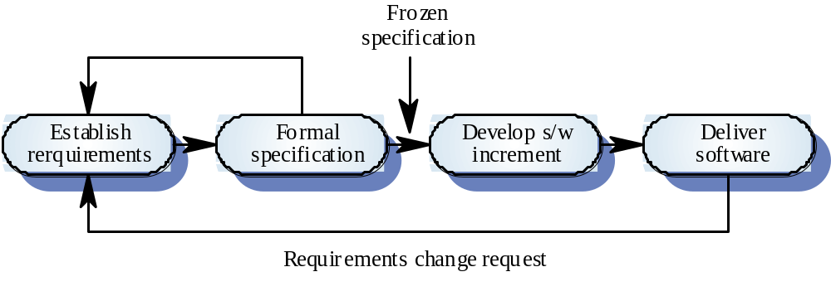
Incremental development

Slide 6
Benefits
Zero failures in the field
  that’s the goal any way
  a realistic expectation is < 5 failures per KLOC on first program execution in the first team project
Short development cycles
  results from use incremental strategy and avoidance of rework
  new teams should experience a two-fold productivity increase on the first project and continue the increase
Longer product life
  investments detailed specifications and usage models help keep a product viable longer

Slide 7
Why are Cleanroom Techniques Not Widely Used
Some people believe cleanroom techniques are too theoretical, too mathematical, and too radical for use in real software development
Relies on correctness verification and statistical quality control rather than unit testing (a major departure from traditional software development)
Organizations operating at the ad hoc level of the Capability Maturity Model, do not make rigorous use of the defined processes needed in all phases of the software life cycle

Slide 8
Cleanroom Principles - part 1
Small teams
  independent specification, development, and certification sub-teams
Incremental development under statistical quality control
  performance assessed during each increment using measure like errors per KLOC, rate of growth in MTTF, or number of sequential error-free test cases
  feedback is used for process improvement and the development plan is adjusted as needed

Slide 9
Cleanroom Process Teams
Specification team
  develops and maintains the system specification
Development team
  develops and verifies software
  the software is not compiled or executes during verification
Certification team
  develops set of statistical test to exercise software after development
  reliability growth models used to assess reliability

Slide 10
Cleanroom Principles - part 2
Software development based on mathematical principles
  the box principle is used for specification and design
  formal verification is used to confirm correctness of implementation of specification
  program correctness is verified by team reviews using questionnaires
Testing based on statistical principles
  operational usage profiles needed
  test cases are randomly generated from the usage model
  failure data is interpreted using statistical models

Slide 11
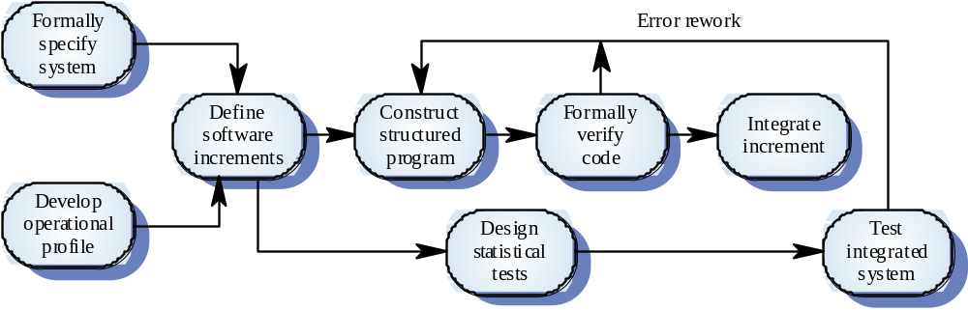
Cleanroom Process Overview

Slide 12
Cleanroom Strategy - part 1
Increment planning.
  The project plan is built around the incremental strategy.
Requirements gathering.
  Customer requirements are elicited and refined for each increment using traditional methods.
Box structure specification.
  Box structures isolate and separate the definition of behavior, data, and procedures at each level of refinement.

Slide 13
Cleanroom Strategy - part 2
Formal design.
  Specifications (black-boxes) are iteratively refined to become architectural designs (state-boxes) and component-level designs (clear boxes).
Correctness verification.
  Correctness questions are asked and answered, formal mathematical verification is used as required.

Slide 14
Cleanroom Strategy - part 3
Code generation, inspection, verification.
  Box structures are translated into program language; inspections are used to ensure conformance of code and boxes, as well as syntactic correctness of code; followed by correctness verification of the code.
Statistical test planning.
  A suite of test cases is created to match the probability distribution of the projected product usage pattern.

Slide 15
Cleanroom Strategy - part 4
Statistical use testing.
  A statistical sample of all possible test cases is used rather than exhaustive testing.
Certification.
  Once verification, inspection, and usage testing are complete and all defects removed, the increment is certified as ready for integration.

Slide 16
Increment Planning - Purpose
Developing the right systems the first time, requires customer involvement and feedback throughout the development process
Facilitates the customer’s clarification of system requirements
Requires management control of resources and technical control of complexity
Product quality requires process measurement and control throughout the SW development cycle

Slide 17
Increment Planning - Benefits
Concurrent engineering by scheduling parallel development and certification
Stepwise integration through testing cumulative increments
Continuous quality feedback from statistical process control
Continuous customer feedback from actual use
Risk management by treating high-risk elements in early increments
Change management by systematic accommodation of changes

Slide 18
Black Box
Specifies a set of transition rules that describe the behavior of system components as responses to specific stimuli, makes use of inheritance in a manner similar to classes
Specifies system function by mapping all possible stimulus histories to all possible responses
S* → R
stimulus history → responses

Slide 19
State Box
Generalization of a state machine, encapsulates the data and operations similar to an object, the inputs (stimuli) and outputs (responses) are represented, data that must be retained between transitions is encapsulated
The state is the encapsulation of the stimulus history
State variables are invented to save any stimuli that need to retained
S x T → R x T
stimuli X state data → responses X state data

Slide 20
Clear Box
Contains the procedural design of the state box, in a manner similar to structured programming
Specifies both data flow and control flow
S x T → R x T
stimuli X state data → responses X state data
State update and response production is allowed

Slide 21
Box Principles
Transaction closure of stimuli and responses
  users and uses are considered including security and error recovery
State migration within box hierarchy
  downward migration of state data is possible whenever new black boxes are created inside a clear box
  upward migration of state date is desirable when duplicate data is updated in several places in the tree
Common services
  reusable boxes from library

Slide 22
Formal Specification and Inspections
The state-based model is treated as a system specification
The inspection process checks the program against the state-based model
The programming approach used is defined to make clear the correspondence between the model and the implemented system
The proofs used resemble mathematical arguments and are used to increase confidence in the inspection process

Slide 23
Design Verification Advantages
Reduces verification to a finite process
Improves quality
Lets cleanroom teams verify every line of code
Results in near zero levels of defects
Scales up to larger systems and higher levels
Produces better code than unit testing

Slide 24
Certification Steps
Usage scenarios must be created
Usage profile is specified
Test cases generated from the usage profile
Tests are executed and failure data are recorded and analyzed
Reliability is computed and recorded

Slide 25
Usage Specification
High-level characterization of the operational environment of the software
User - person, device, or piece of software
Use - work session, transaction, or other unit of service
Usage Environment - platform, system load, concurrency, multi-user, etc.
Usage classes - clusters of similar users doing similar tasks

Slide 26
Usage Modeling
Might be represented as a
  graph
  transition matrix
  Markov chain (adjacency matrix, arc probabilities as cell entries)
A probability usage distribution can be defined by
  assignments based on field data
  informed assumptions about expected usage
  uniform probabilities (if no information is available)
Optimization using operations research techniques
  may be used to support test management objectives
  does not require modelers to over specify knowledge about usage

Slide 27
Statistical Testing
Generation of test cases
  each test case begins in a start state and represents a random walk through the usage model ending at a designated end state
Control of statistical testing
  a well-defined procedure is performed under specified conditions
  each performance is a trial and can be used as part of an empirical probability computation
Stopping criteria for testing
  when testing goals or quality standards are achieved
  when the difference between the predicted usage chain and the actual testing chain becomes very small

Slide 28
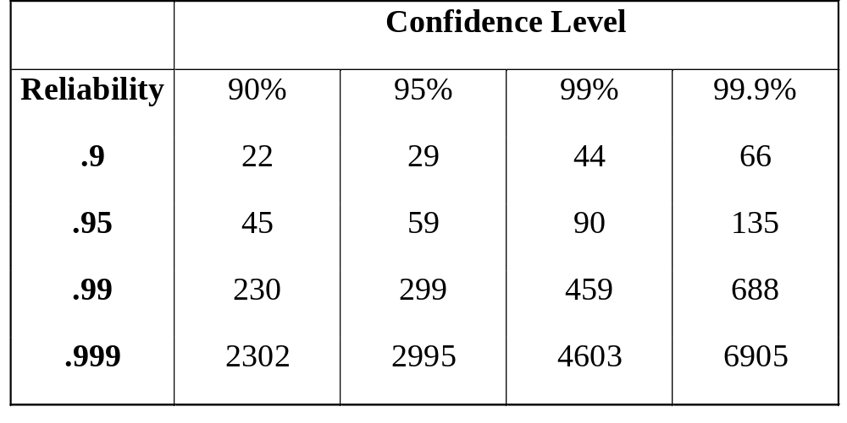
Reliability Estimation
The binomial distribution can be used to estimate the number of error-free test cases are needed to assume a given level of reliability at a specified confidence level.

Slide 29
Cleanroom Certification Models
Sampling model
  determines the number if random cases that need to be executed to achieve a particular reliability level
Component model
  allows analyst to determine the probability that a given component in a multi-component system fails prior to completion
Certification model
  projected overall reliability of system

Slide 30
Process Control
Involves comparing actual performance on a task with pre-established standards and using the results to make process management decisions.
Measurement of key process variables is central to process control.
In cleanroom software process there are many times that team members compare their progress against a standard and decide whether to continue or redo a portion of their project work.

Slide 31
Process Improvement
May take both quantitative and qualitative forms.
Statistical quality control is an example of a quantitative approach to process improvement found in cleanroom software process.
Root cause analysis is and example of qualitative process improvement found in the cleanroom software process. After each certification failure error causes are identified and ways to prevent them from reoccurring are sought.

Slide 32
Cleanroom Process Evaluation
Some organizations have achieved impressive results and have delivered systems with few faults
Independent assessment shows that the process is no more expensive the other approaches
Produces products with fewer errors than traditional software engineering techniques
Hard to see how this approach can be used by inexperienced software engineers
Requires highly a motivated development team

Slide 33
Cleanroom and Object-Oriented SE
Common Characteristics
Lifecycle
  both rely on incremental development
Usage
  cleanroom usage model similar to OO use case
State Machine Use
  cleanroom state box and OO transition diagram
Reuse
  explicit objective in both process models

Slide 34
Cleanroom and Object-Oriented SE
Key Differences
Cleanroom relies on decomposition OO relies on composition
Cleanroom relies on formal methods while OO allows informal use case definition and testing
OO inheritance hierarchy is a design resource where cleanroom usage hierarchy is system itself
OO practitioners prefer graphical representations while cleanroom practitioners prefer tabular representations
Tool support is good for most OO processes, but usually tool support is only found in cleanroom testing not design

